Slide 1
ATTRITION OF ABC
HR-ANALYTICS
CBA-03

Slide 2
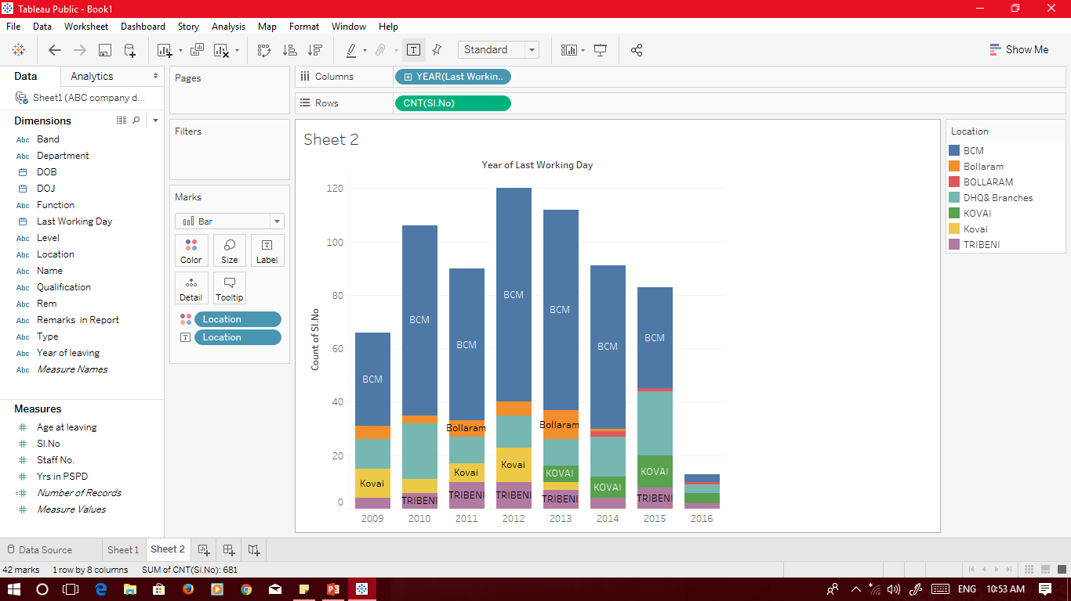
Year-Wise Attrition
Bollaram Branch is seeing Attrition from 2014 onwards
In any given Year BCM Branch is having highest attrition
Highest in any year is 2012
Least in any year is 2016

Slide 3
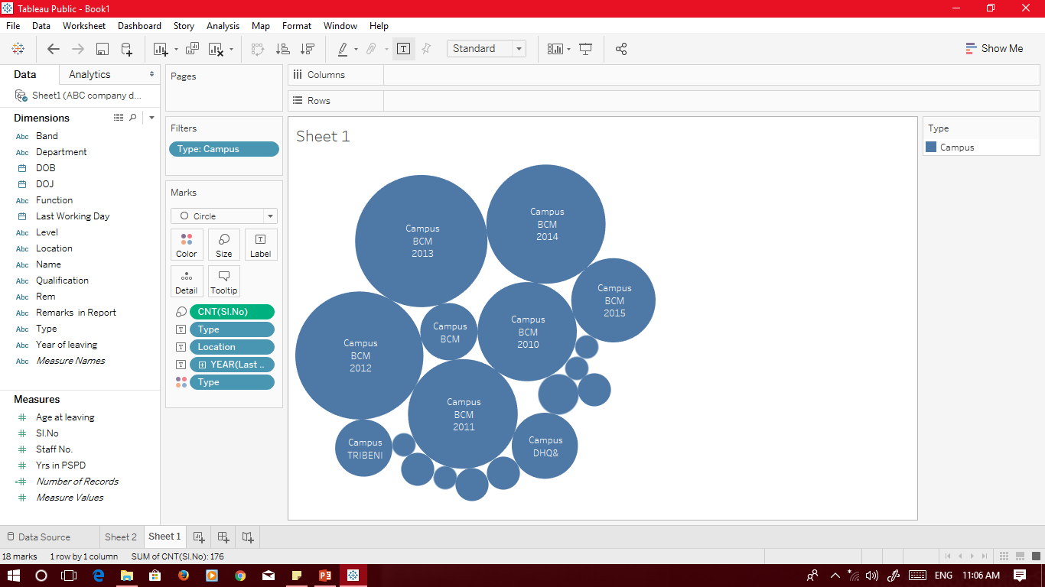
Year-Wise Campus Attrition
Highest is in 2013 from BCM location – 32
Lowest is 1 in 2013,2014,2016 from Bolaram, Tribeni, Kovai and BCM

Slide 4
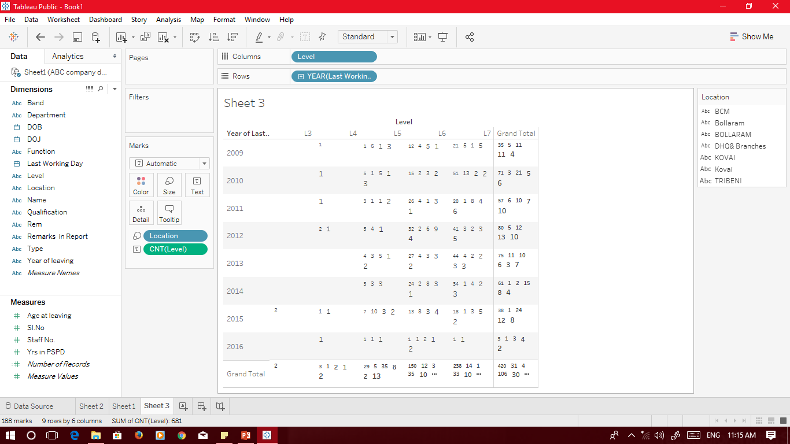
Level-Wise Attrition
Highest is from L7 from location BCM in year 2010
Lowest is from L4 Kovai 2016

Slide 5
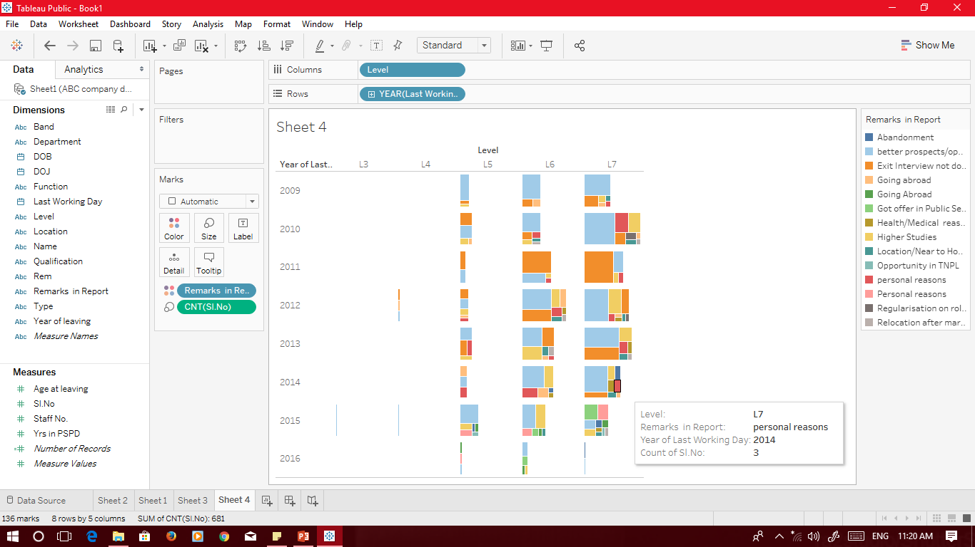
Reasons For Attrition Level Wise
First highest reason is better prospectus
Second highest reason is exit not done properly

Slide 6
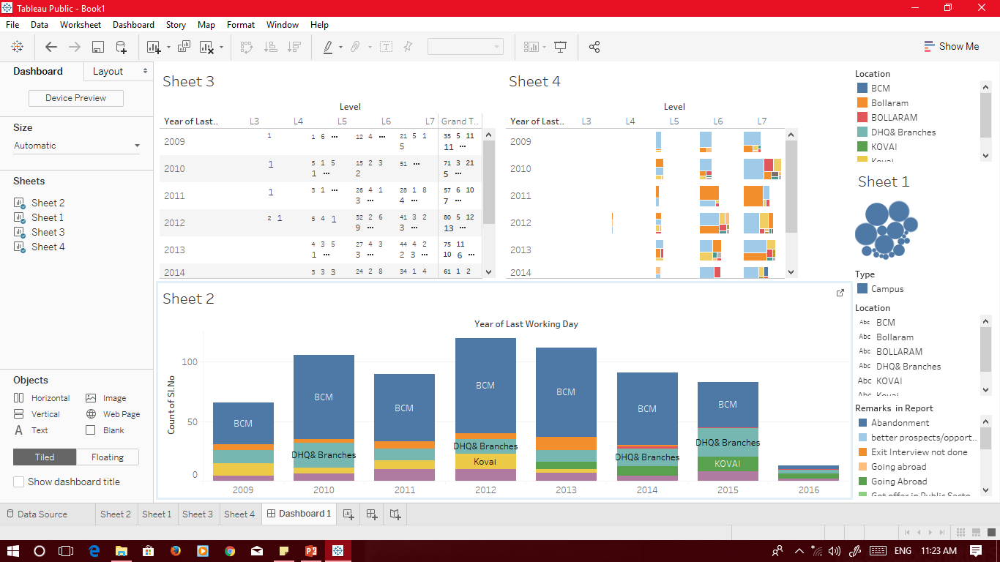
Highlights
We can conclude that in any given year BCM location
is having highest attrition rate either it may be Level wise or Campus wise.
Therefore Organisation should keep more focus on that location
Need to focus on the employee challenges for retaining this talent.

